Slide 1


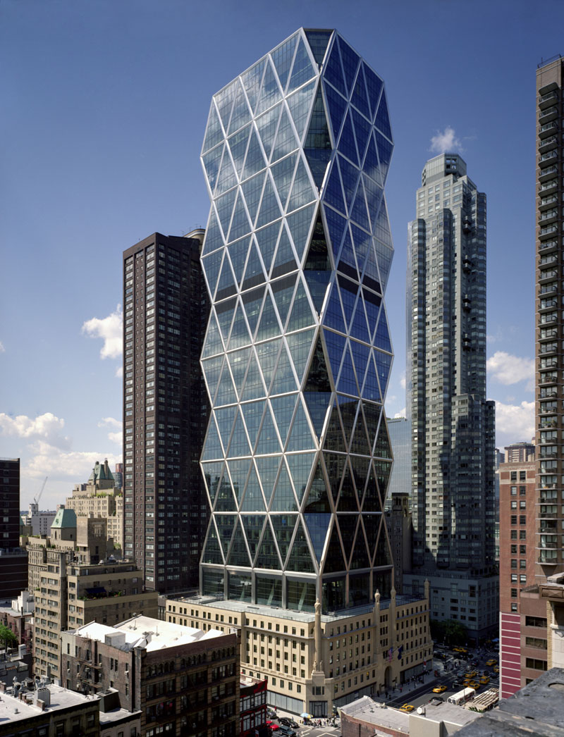


Análisis estructural avanzado
INGENIERÍA CIVIL
DOCENTE:
M.C. ANTONIO DANIEL MARTÍNEZ DIBENE
UNIDAD III: RIGIDECES
TEMA: MARCOS
INSTITUTO TECNOLÒGICO DE LA PAZ

Slide 2
Contenido
Marco Empotrado - Empotrado
Marco Articulado - Articulado
Marco Articulado – Articulado con Carga puntual
Conclusiones
Bibliografía

Slide 3
Empotrado - Empotrado
Marco Doblemente Empotrado
Determine las reacciones en los soportes fijos 1 y 3 . Considere que E = 200 Gpa, I = 300(10^6) mm^4 y A = 10(10^3) mm^2 para cada elemento.
Y
Con restricción = | 1
Sin Restricción = | 0
NUDO | X | Y | RESTRICCIONES
 |  |  | x | y | z
1 | 0 | 4 | 1 | 1 | 1
2 | 4 | 4 | 0 | 0 | 0
3 | 4 | 0 | 1 | 1 | 1
X

Slide 4
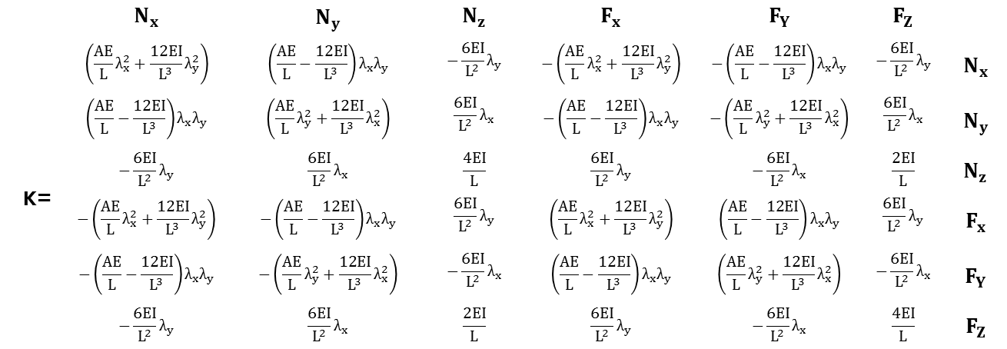
Empotrado - Empotrado
Matriz de Rigidez del Miembro 1
 | $$N_{x}$$ | $$N_{y}$$ | $$N_{z}$$ | $$F_{x}$$ | $$F_{Y}$$ | $$F_{Z}$$
 | $$\left(\frac{AE}{L}λ_{x}^{2}+\frac{12EI}{L^{3}}λ_{y}^{2}\right)$$ | $$\left(\frac{AE}{L}−\frac{12EI}{L^{3}}\right)λ_{x}λ_{y}$$ | $$−\frac{6EI}{L^{2}}λ_{y}$$ | $$−\left(\frac{AE}{L}λ_{x}^{2}+\frac{12EI}{L^{3}}λ_{y}^{2}\right)$$ | $$−\left(\frac{AE}{L}−\frac{12EI}{L^{3}}\right)λ_{x}λ_{y}$$ | $$−\frac{6EI}{L^{2}}λ_{y}$$ | $$N_{x}$$
 | $$\left(\frac{AE}{L}−\frac{12EI}{L^{3}}\right)λ_{x}λ_{y}$$ | $$\left(\frac{AE}{L}λ_{y}^{2}+\frac{12EI}{L^{3}}λ_{x}^{2}\right)$$ | $$\frac{6EI}{L^{2}}λ_{x}$$ | $$−\left(\frac{AE}{L}−\frac{12EI}{L^{3}}\right)λ_{x}λ_{y}$$ | $$−\left(\frac{AE}{L}λ_{y}^{2}+\frac{12EI}{L^{3}}λ_{x}^{2}\right)$$ | $$\frac{6EI}{L^{2}}λ_{x}$$ | $$N_{y}$$
K= | $$−\frac{6EI}{L^{2}}λ_{y}$$ | $$\frac{6EI}{L^{2}}λ_{x}$$ | $$\frac{4EI}{L}$$ | $$\frac{6EI}{L^{2}}λ_{y}$$ | $$−\frac{6EI}{L^{2}}λ_{x}$$ | $$\frac{2EI}{L}$$ | $$N_{z}$$
 | $$−\left(\frac{AE}{L}λ_{x}^{2}+\frac{12EI}{L^{3}}λ_{y}^{2}\right)$$ | $$−\left(\frac{AE}{L}−\frac{12EI}{L^{3}}\right)λ_{x}λ_{y}$$ | $$\frac{6EI}{L^{2}}λ_{y}$$ | $$\left(\frac{AE}{L}λ_{x}^{2}+\frac{12EI}{L^{3}}λ_{y}^{2}\right)$$ | $$\left(\frac{AE}{L}−\frac{12EI}{L^{3}}\right)λ_{x}λ_{y}$$ | $$\frac{6EI}{L^{2}}λ_{y}$$ | $$F_{x}$$
 | $$−\left(\frac{AE}{L}−\frac{12EI}{L^{3}}\right)λ_{x}λ_{y}$$ | $$−\left(\frac{AE}{L}λ_{y}^{2}+\frac{12EI}{L^{3}}λ_{x}^{2}\right)$$ | $$−\frac{6EI}{L^{2}}λ_{x}$$ | $$\left(\frac{AE}{L}−\frac{12EI}{L^{3}}\right)λ_{x}λ_{y}$$ | $$\left(\frac{AE}{L}λ_{y}^{2}+\frac{12EI}{L^{3}}λ_{x}^{2}\right)$$ | $$−\frac{6EI}{L^{2}}λ_{x}$$ | $$F_{Y}$$
 | $$−\frac{6EI}{L^{2}}λ_{y}$$ | $$\frac{6EI}{L^{2}}λ_{x}$$ | $$\frac{2EI}{L}$$ | $$\frac{6EI}{L^{2}}λ_{y}$$ | $$−\frac{6EI}{L^{2}}λ_{x}$$ | $$\frac{4EI}{L}$$ | $$F_{Z}$$

Slide 5


Empotrado - Empotrado
Matriz de Rigidez Miembro 1
X
EXTREMO LEJANO = | 4 | EXTREMO CERCANO = | 0
Y
EXTREMO LEJANO = | 0 | EXTREMO CERCANO = | 0
Nx= | 7 | Fx= | 1
Ny= | 8 | Fy= | 2
Nz= | 9 | Fz= | 3
λx= 1 λy= 0
 | 7 | 8 | 9 | 1 | 2 | 3
 | 500 | 0 | 0 | -500 | 0 | 0 | 7
 | 0 | 11.25 | 22.5 | 0 | -11.25 | 22.5 | 8
K1= | 0 | 22.5 | 60 | 0 | -22.5 | 30 | 9
 | -500 | 0 | 0 | 500 | 0 | 0 | 1
 | 0 | -11.25 | -22.5 | 0 | 11.25 | -22.5 | 2
 | 0 | 22.5 | 30 | 0 | -22.5 | 60 | 3
x ${10}^{6}$
$$({10}^{6})$$

Slide 6
Empotrado - Empotrado
Matriz de Rigidez del Miembro 2
 | $$N_{x}$$ | $$N_{y}$$ | $$N_{z}$$ | $$F_{x}$$ | $$F_{Y}$$ | $$F_{Z}$$
 | $$\left(\frac{AE}{L}λ_{x}^{2}+\frac{12EI}{L^{3}}λ_{y}^{2}\right)$$ | $$\left(\frac{AE}{L}−\frac{12EI}{L^{3}}\right)λ_{x}λ_{y}$$ | $$−\frac{6EI}{L^{2}}λ_{y}$$ | $$−\left(\frac{AE}{L}λ_{x}^{2}+\frac{12EI}{L^{3}}λ_{y}^{2}\right)$$ | $$−\left(\frac{AE}{L}−\frac{12EI}{L^{3}}\right)λ_{x}λ_{y}$$ | $$−\frac{6EI}{L^{2}}λ_{y}$$ | $$N_{x}$$
 | $$\left(\frac{AE}{L}−\frac{12EI}{L^{3}}\right)λ_{x}λ_{y}$$ | $$\left(\frac{AE}{L}λ_{y}^{2}+\frac{12EI}{L^{3}}λ_{x}^{2}\right)$$ | $$\frac{6EI}{L^{2}}λ_{x}$$ | $$−\left(\frac{AE}{L}−\frac{12EI}{L^{3}}\right)λ_{x}λ_{y}$$ | $$−\left(\frac{AE}{L}λ_{y}^{2}+\frac{12EI}{L^{3}}λ_{x}^{2}\right)$$ | $$\frac{6EI}{L^{2}}λ_{x}$$ | $$N_{y}$$
K= | $$−\frac{6EI}{L^{2}}λ_{y}$$ | $$\frac{6EI}{L^{2}}λ_{x}$$ | $$\frac{4EI}{L}$$ | $$\frac{6EI}{L^{2}}λ_{y}$$ | $$−\frac{6EI}{L^{2}}λ_{x}$$ | $$\frac{2EI}{L}$$ | $$N_{z}$$
 | $$−\left(\frac{AE}{L}λ_{x}^{2}+\frac{12EI}{L^{3}}λ_{y}^{2}\right)$$ | $$−\left(\frac{AE}{L}−\frac{12EI}{L^{3}}\right)λ_{x}λ_{y}$$ | $$\frac{6EI}{L^{2}}λ_{y}$$ | $$\left(\frac{AE}{L}λ_{x}^{2}+\frac{12EI}{L^{3}}λ_{y}^{2}\right)$$ | $$\left(\frac{AE}{L}−\frac{12EI}{L^{3}}\right)λ_{x}λ_{y}$$ | $$\frac{6EI}{L^{2}}λ_{y}$$ | $$F_{x}$$
 | $$−\left(\frac{AE}{L}−\frac{12EI}{L^{3}}\right)λ_{x}λ_{y}$$ | $$−\left(\frac{AE}{L}λ_{y}^{2}+\frac{12EI}{L^{3}}λ_{x}^{2}\right)$$ | $$−\frac{6EI}{L^{2}}λ_{x}$$ | $$\left(\frac{AE}{L}−\frac{12EI}{L^{3}}\right)λ_{x}λ_{y}$$ | $$\left(\frac{AE}{L}λ_{y}^{2}+\frac{12EI}{L^{3}}λ_{x}^{2}\right)$$ | $$−\frac{6EI}{L^{2}}λ_{x}$$ | $$F_{Y}$$
 | $$−\frac{6EI}{L^{2}}λ_{y}$$ | $$\frac{6EI}{L^{2}}λ_{x}$$ | $$\frac{2EI}{L}$$ | $$\frac{6EI}{L^{2}}λ_{y}$$ | $$−\frac{6EI}{L^{2}}λ_{x}$$ | $$\frac{4EI}{L}$$ | $$F_{Z}$$

Slide 7

Empotrado - Empotrado
Matriz de Rigidez del Miembro 2
Nx= | 1 | Fx= | 4
Ny= | 2 | Fy= | 5
Nz= | 3 | Fz= | 6
X
EXTREMO LEJANO = | 0 | EXTREMO CERCANO = | 0
Y
EXTREMO LEJANO = | -4 | EXTREMO CERCANO = | 0
λx= 0 λy= -1
 | 1 | 2 | 3 | 4 | 5 | 6
 | 11.25 | 0 | 22.5 | -11.25 | 0 | 22.5 | 1
 | 0 | 500 | 0 | 0 | -500 | 0 | 2
K2= | 22.5 | 0 | 60 | -22.5 | 0 | 30 | 3
 | -11.25 | 0 | -22.5 | 11.25 | 0 | -22.5 | 4
 | 0 | -500 | 0 | 0 | 500 | 0 | 5
 | 22.5 | 0 | 30 | -22.5 | 0 | 60 | 6
x ${10}^{6}$
$$({10}^{6})$$

Slide 8



Empotrado - Empotrado
Ensamblando la matriz
K = K1 + K2
 | 7 | 8 | 9 | 1 | 2 | 3
 | 500 | 0 | 0 | -500 | 0 | 0 | 7
 | 0 | 11.25 | 22.5 | 0 | -11.25 | 22.5 | 8
K1= | 0 | 22.5 | 60 | 0 | -22.5 | 30 | 9
 | -500 | 0 | 0 | 500 | 0 | 0 | 1
 | 0 | -11.25 | -22.5 | 0 | 11.25 | -22.5 | 2
 | 0 | 22.5 | 30 | 0 | -22.5 | 60 | 3
 | 1 | 2 | 3 | 4 | 5 | 6
 | 11.25 | 0 | 22.5 | -11.25 | 0 | 22.5 | 1
 | 0 | 500 | 0 | 0 | -500 | 0 | 2
K2= | 22.5 | 0 | 60 | -22.5 | 0 | 30 | 3
 | -11.25 | 0 | -22.5 | 11.25 | 0 | -22.5 | 4
 | 0 | -500 | 0 | 0 | 500 | 0 | 5
 | 22.5 | 0 | 30 | -22.5 | 0 | 60 | 6
+
x ${10}^{6}$
x ${10}^{6}$
$$({10}^{6})$$
$$({10}^{6})$$
$$({10}^{6})$$

Slide 9



Empotrado - Empotrado
Ensamblando la matriz
 | 511.25 | 0 | 22.5 | -11.25 | 0 | 22.5 | -500 | 0 | 0
 | 0 | 511.25 | -22.5 | 0 | -500 | 0 | 0 | -11.25 | -22.5
 | 22.5 | -22.5 | 120 | -22.5 | 0 | 30 | 0 | 22.5 | 30
 | -11.25 | 0 | -22.5 | 11.25 | 0 | -22.5 | 0 | 0 | 0
K= | 0 | -500 | 0 | 0 | 500 | 0 | 0 | 0 | 0
 | 22.5 | 0 | 30 | -22.5 | 0 | 60 | 0 | 0 | 0
 | -500 | 0 | 0 | 0 | 0 | 0 | 500 | 0 | 0
 | 0 | -11.25 | 22.5 | 0 | 0 | 0 | 0 | 11.25 | 22.5
 | 0 | -22.5 | 30 | 0 | 0 | 0 | 0 | 22.5 | 60
x ${10}^{6}$
$$({10}^{6})$$
$$({10}^{6})$$
$$({10}^{6})$$

Slide 10

Empotrado - Empotrado
Marco Doblemente Empotrado – Cargas y desplazamientos
DATOS
W = | 12
L = | 4
Momento de empotramiento
A= | 16.000
B= | -16.000
Cortantes
A= | 24
B= | 24

Slide 11
Empotrado - Empotrado
Marco Doblemente Empotrado – Cargas Externas
DATOS
w= | 10
L= | 4
Momento de empotramiento
A= | 5.000
B= | -5.000
Cortantes
A= | 5
B= | 5

Slide 12


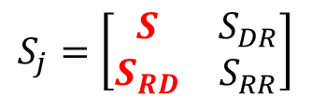

Empotrado - Empotrado
Marco Doblemente – Relación Carga Desplazamiento
-5000 | 1
-24000 | 2
11000 | 3
0 | 4
0 | 5
0 | 6
0 | 7
0 | 8
0 | 9
$$Q_{k=}$$
Q = KD
$$S_{j}=\left[\begin{matrix}S & S_{DR} \\ S_{RD} & S_{RR}\end{matrix}\right]$$
$$D_{k}=$$
-5000
-24000
11000
0.00
0.00
0.00
0.00
0.00
0.00
511.25 | 0 | 22.5 | -11.25 | 0 | 22.5 | -500 | 0 | 0
0 | 511.25 | -22.5 | 0 | -500 | 0 | 0 | -11.25 | -22.5
22.5 | -22.5 | 120 | -22.5 | 0 | 30 | 0 | 22.5 | 30
-11.25 | 0 | -22.5 | 11.25 | 0 | -22.5 | 0 | 0 | 0
0 | -500 | 0 | 0 | 500 | 0 | 0 | 0 | 0
22.5 | 0 | 30 | -22.5 | 0 | 60 | 0 | 0 | 0
-500 | 0 | 0 | 0 | 0 | 0 | 500 | 0 | 0
0 | -11.25 | 22.5 | 0 | 0 | 0 | 0 | 11.25 | 22.5
0 | -22.5 | 30 | 0 | 0 | 0 | 0 | 22.5 | 60
D1
D2
D3
0.00
0.00
0.00
0.00
0.00
0.00
=
x
x ${10}^{6}$

Slide 13







Empotrado - Empotrado
Marco Doblemente Empotrado – Sistemas de Ecuaciones
Matriz S
 |  |  |  | MATRIZ INVERSA DE S |  |  |  | MATRIZ DE CARGAS
D1 |  |  |  | 0.002 | -1.6411E-05 | 0.000 |  | -5000.000
D2 |  |  | = | 0.000 | 0.0019724 | 0.000 | x | -24000.00
D3 |  |  |  | 0.000 | 0.0003729 | 0.008 |  | 11000.000
511.25 | D1 + | 0 | D2 + | 22.5 | D3
0 | D1 + | 511.25 | D2 - | 22.5 | D3
22.5 | D1 - | 22.5 | D2 + | 120 | D3
x ${10}^{6}$
Q$K^{−1}$ = D
DESPLAZAMIENTOS
D1 = | -13.5701 | m
D2 = | -43.1537 | m
D3 = | 86.1197 | rad
x ${10}^{−6}$
x ${10}^{−6}$
x ${10}^{−6}$
$$({10}^{−6})$$
$$({10}^{−6})$$
$$({10}^{−6})$$

Slide 14


Empotrado - Empotrado
Marco Doblemente Empotrado – Obtención de Cargas
MATRIZ |  |  | DESPLAZAMIENTOS
-11.25 | 0 | -22.5 |  | -13.570
0 | -500 | 0
22.5 | 0 | 30 |  | -43.154
-500 | 0 | 0
0 | -11.25 | 22.5 |  | 86.120
0 | -22.5 | 30
x ${10}^{6}$
CARGAS
 | Q4 = | -1.785 | KN
 | Q5 = | 21.577 | KN
 | Q6 = | 2.278 | KN * m
 | Q7 = | 6.785 | KN
 | Q8 = | 2.423 | KN
 | Q9 = | 3.555 | KN * m
$$S_{RD}$$

Slide 15
Empotrado - Empotrado
Marco Doblemente Empotrado - Reacciones
R4 = | -1.785 | + | 5.000
R5 = | 21.577 | + | 0.000
R6 = | 2.278 | - | -5.000
R7 = | 6.785 | + | 0.000
R8 = | 2.423 | + | 24.000
R9 = | 3.555 | + | 16.000
R4 = | 3.215 | KN
R5 = | 21.577 | KN
R6 = | -2.722 | KN * m
R7 = | 6.785 | KN
R8 = | 26.423 | KN
R9 = | 19.555 | KN * m

Slide 16
MARCO ARTICULADO - ARTICULADO
Marco Articulado – Articulado
Determine las reacciones en los soportes articulados ① y ③. Considere E = 29 Ksi, I = 700 ${in}^{4}$ y A = 20 ${in}^{2}$, para cada elemento.
Dado el modelo analítico mostrado, la figura tiene 5 grados de libertad sin restricción. Los cuales corresponden, 3 desplazamientos (giros) en el eje Z de los nodos ①, ② y ③. Y dos desplazamientos en el nodo ② en el eje X y Y.
Y
X

Slide 17
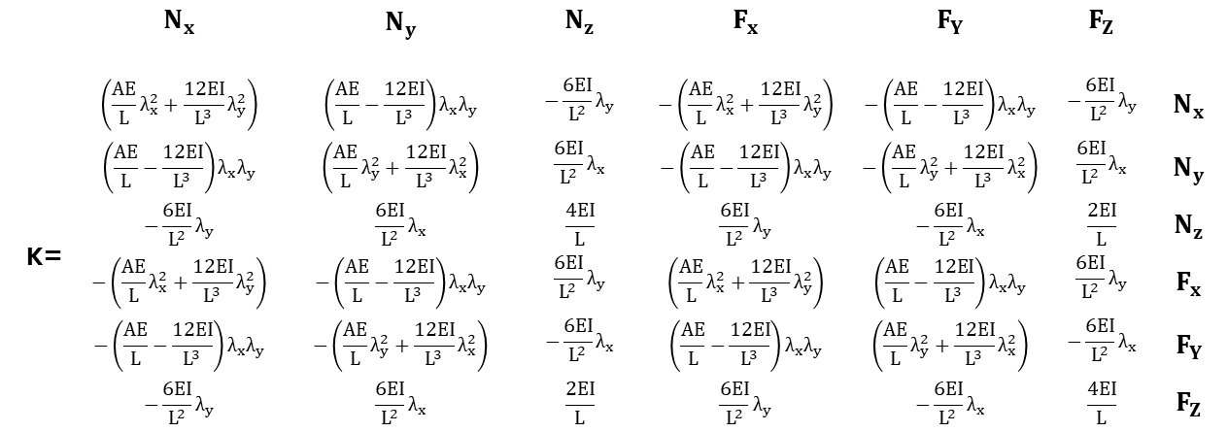


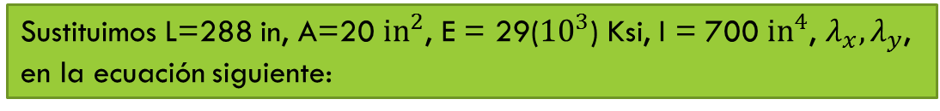
MARCO ARTICULADO - ARTICULADO
Matriz de Rigidez del Miembro 1
Sustituimos L=288 in, A=20 ${in}^{2}$, E = 29(${10}^{3}$) Ksi, I = 700 ${in}^{4}$, $λ_{x},λ_{y}$, en la ecuación siguiente:
 | $$N_{x}$$ | $$N_{y}$$ | $$N_{z}$$ | $$F_{x}$$ | $$F_{Y}$$ | $$F_{Z}$$
 | $$\left(\frac{AE}{L}λ_{x}^{2}+\frac{12EI}{L^{3}}λ_{y}^{2}\right)$$ | $$\left(\frac{AE}{L}−\frac{12EI}{L^{3}}\right)λ_{x}λ_{y}$$ | $$−\frac{6EI}{L^{2}}λ_{y}$$ | $$−\left(\frac{AE}{L}λ_{x}^{2}+\frac{12EI}{L^{3}}λ_{y}^{2}\right)$$ | $$−\left(\frac{AE}{L}−\frac{12EI}{L^{3}}\right)λ_{x}λ_{y}$$ | $$−\frac{6EI}{L^{2}}λ_{y}$$ | $$N_{x}$$
 | $$\left(\frac{AE}{L}−\frac{12EI}{L^{3}}\right)λ_{x}λ_{y}$$ | $$\left(\frac{AE}{L}λ_{y}^{2}+\frac{12EI}{L^{3}}λ_{x}^{2}\right)$$ | $$\frac{6EI}{L^{2}}λ_{x}$$ | $$−\left(\frac{AE}{L}−\frac{12EI}{L^{3}}\right)λ_{x}λ_{y}$$ | $$−\left(\frac{AE}{L}λ_{y}^{2}+\frac{12EI}{L^{3}}λ_{x}^{2}\right)$$ | $$\frac{6EI}{L^{2}}λ_{x}$$ | $$N_{y}$$
K= | $$−\frac{6EI}{L^{2}}λ_{y}$$ | $$\frac{6EI}{L^{2}}λ_{x}$$ | $$\frac{4EI}{L}$$ | $$\frac{6EI}{L^{2}}λ_{y}$$ | $$−\frac{6EI}{L^{2}}λ_{x}$$ | $$\frac{2EI}{L}$$ | $$N_{z}$$
 | $$−\left(\frac{AE}{L}λ_{x}^{2}+\frac{12EI}{L^{3}}λ_{y}^{2}\right)$$ | $$−\left(\frac{AE}{L}−\frac{12EI}{L^{3}}\right)λ_{x}λ_{y}$$ | $$\frac{6EI}{L^{2}}λ_{y}$$ | $$\left(\frac{AE}{L}λ_{x}^{2}+\frac{12EI}{L^{3}}λ_{y}^{2}\right)$$ | $$\left(\frac{AE}{L}−\frac{12EI}{L^{3}}\right)λ_{x}λ_{y}$$ | $$\frac{6EI}{L^{2}}λ_{y}$$ | $$F_{x}$$
 | $$−\left(\frac{AE}{L}−\frac{12EI}{L^{3}}\right)λ_{x}λ_{y}$$ | $$−\left(\frac{AE}{L}λ_{y}^{2}+\frac{12EI}{L^{3}}λ_{x}^{2}\right)$$ | $$−\frac{6EI}{L^{2}}λ_{x}$$ | $$\left(\frac{AE}{L}−\frac{12EI}{L^{3}}\right)λ_{x}λ_{y}$$ | $$\left(\frac{AE}{L}λ_{y}^{2}+\frac{12EI}{L^{3}}λ_{x}^{2}\right)$$ | $$−\frac{6EI}{L^{2}}λ_{x}$$ | $$F_{Y}$$
 | $$−\frac{6EI}{L^{2}}λ_{y}$$ | $$\frac{6EI}{L^{2}}λ_{x}$$ | $$\frac{2EI}{L}$$ | $$\frac{6EI}{L^{2}}λ_{y}$$ | $$−\frac{6EI}{L^{2}}λ_{x}$$ | $$\frac{4EI}{L}$$ | $$F_{Z}$$
$$λ_{x}=\frac{288 −0}{288} =1$$
$$λ_{y}=\frac{0 −0}{288} =0$$

Slide 18


MARCO ARTICULADO - ARTICULADO
Matriz de Rigidez del Miembro 1
Como resultado obtenemos:
$$λ_{x}=\frac{288 −0}{288} =1$$
$$λ_{y}=\frac{0 −0}{288} =0$$
 | 8 | 9 | 5 | 1 | 2 | 3
 | 2013.89 | 0.00 | 0.00 | -2013.89 | 0.00 | 0.00 | 8
 | 0.00 | 10.20 | 1468.46 | 0.00 | -10.20 | 1468.46 | 9
K1= | 0.00 | 1468.46 | 281944.44 | 0.00 | -1468.46 | 140972.22 | 5
 | -2013.89 | 0.00 | 0.00 | 2013.89 | 0.00 | 0.00 | 1
 | 0.00 | -10.20 | -1468.46 | 0.00 | 10.20 | -1468.46 | 2
 | 0.00 | 1468.46 | 140972.22 | 0.00 | -1468.46 | 281944.44 | 3

Slide 19
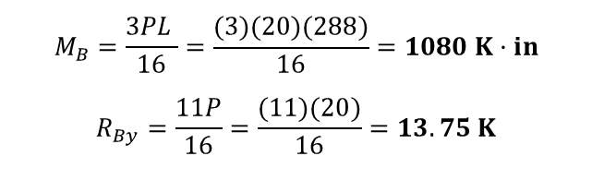
MARCO ARTICULADO - ARTICULADO
Momentos de Empotramiento Perfecto del Miembro 1
Debido a que las cargas no están aplicadas sobre los nudos, las transformamos en cargas equivalentes mediante las formulas de empotramiento perfecto.
Evaluamos los momentos de empotramiento debido a la carga de 20 K utilizando las expresiones siguiente:
$$M_{B}=\frac{3PL }{16}=\frac{(3)(20)(288)}{16}=1080 K·in$$
$$R_{By}=\frac{11P}{16}=\frac{(11)(20)}{16}=13.75 K$$

Slide 20
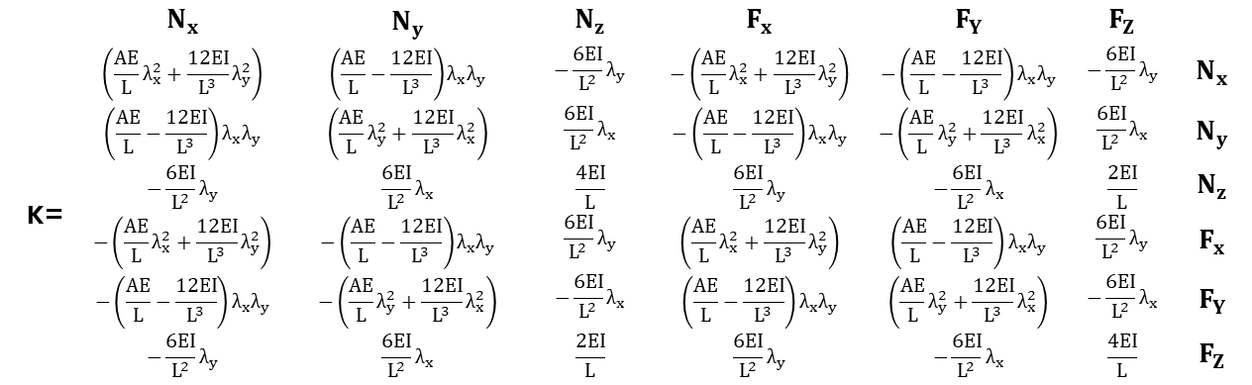



MARCO ARTICULADO - ARTICULADO
Matriz de Rigidez del Miembro 2
Sustituimos L=192 in, A=20 ${in}^{2}$, E = 29 Ksi, I = 700 ${in}^{4}$, $λ_{x},λ_{y}$, en la ecuación siguiente:
$$λ_{x}=\frac{0 −0}{192} =0$$
$$λ_{y}=\frac{192 −0}{192} =1$$
 | $$N_{x}$$ | $$N_{y}$$ | $$N_{z}$$ | $$F_{x}$$ | $$F_{Y}$$ | $$F_{Z}$$
 | $$\left(\frac{AE}{L}λ_{x}^{2}+\frac{12EI}{L^{3}}λ_{y}^{2}\right)$$ | $$\left(\frac{AE}{L}−\frac{12EI}{L^{3}}\right)λ_{x}λ_{y}$$ | $$−\frac{6EI}{L^{2}}λ_{y}$$ | $$−\left(\frac{AE}{L}λ_{x}^{2}+\frac{12EI}{L^{3}}λ_{y}^{2}\right)$$ | $$−\left(\frac{AE}{L}−\frac{12EI}{L^{3}}\right)λ_{x}λ_{y}$$ | $$−\frac{6EI}{L^{2}}λ_{y}$$ | $$N_{x}$$
 | $$\left(\frac{AE}{L}−\frac{12EI}{L^{3}}\right)λ_{x}λ_{y}$$ | $$\left(\frac{AE}{L}λ_{y}^{2}+\frac{12EI}{L^{3}}λ_{x}^{2}\right)$$ | $$\frac{6EI}{L^{2}}λ_{x}$$ | $$−\left(\frac{AE}{L}−\frac{12EI}{L^{3}}\right)λ_{x}λ_{y}$$ | $$−\left(\frac{AE}{L}λ_{y}^{2}+\frac{12EI}{L^{3}}λ_{x}^{2}\right)$$ | $$\frac{6EI}{L^{2}}λ_{x}$$ | $$N_{y}$$
K= | $$−\frac{6EI}{L^{2}}λ_{y}$$ | $$\frac{6EI}{L^{2}}λ_{x}$$ | $$\frac{4EI}{L}$$ | $$\frac{6EI}{L^{2}}λ_{y}$$ | $$−\frac{6EI}{L^{2}}λ_{x}$$ | $$\frac{2EI}{L}$$ | $$N_{z}$$
 | $$−\left(\frac{AE}{L}λ_{x}^{2}+\frac{12EI}{L^{3}}λ_{y}^{2}\right)$$ | $$−\left(\frac{AE}{L}−\frac{12EI}{L^{3}}\right)λ_{x}λ_{y}$$ | $$\frac{6EI}{L^{2}}λ_{y}$$ | $$\left(\frac{AE}{L}λ_{x}^{2}+\frac{12EI}{L^{3}}λ_{y}^{2}\right)$$ | $$\left(\frac{AE}{L}−\frac{12EI}{L^{3}}\right)λ_{x}λ_{y}$$ | $$\frac{6EI}{L^{2}}λ_{y}$$ | $$F_{x}$$
 | $$−\left(\frac{AE}{L}−\frac{12EI}{L^{3}}\right)λ_{x}λ_{y}$$ | $$−\left(\frac{AE}{L}λ_{y}^{2}+\frac{12EI}{L^{3}}λ_{x}^{2}\right)$$ | $$−\frac{6EI}{L^{2}}λ_{x}$$ | $$\left(\frac{AE}{L}−\frac{12EI}{L^{3}}\right)λ_{x}λ_{y}$$ | $$\left(\frac{AE}{L}λ_{y}^{2}+\frac{12EI}{L^{3}}λ_{x}^{2}\right)$$ | $$−\frac{6EI}{L^{2}}λ_{x}$$ | $$F_{Y}$$
 | $$−\frac{6EI}{L^{2}}λ_{y}$$ | $$\frac{6EI}{L^{2}}λ_{x}$$ | $$\frac{2EI}{L}$$ | $$\frac{6EI}{L^{2}}λ_{y}$$ | $$−\frac{6EI}{L^{2}}λ_{x}$$ | $$\frac{4EI}{L}$$ | $$F_{Z}$$

Slide 21


MARCO ARTICULADO - ARTICULADO
Matriz de Rigidez del Miembro 2
Como resultado obtenemos:
$$λ_{x}=\frac{0 −0}{192} =0$$
$$λ_{y}=\frac{192 −0}{192} =1$$
 | 1 | 2 | 3 | 6 | 7 | 4
 | 34.42 | 0.00 | -3304.04 | -34.42 | 0.00 | -3304.04 | 1
 | 0.00 | 3020.83 | 0.00 | 0.00 | -3020.83 | 0.00 | 2
K2= | -3304.04 | 0.00 | 422916.67 | 3304.04 | 0.00 | 211458.33 | 3
 | -34.42 | 0.00 | 3304.04 | 34.42 | 0.00 | 3304.04 | 6
 | 0.00 | -3020.83 | 0.00 | 0.00 | 3020.83 | 0.00 | 7
 | -3304.04 | 0.00 | 211458.33 | 3304.04 | 0.00 | 422916.67 | 4

Slide 22
MARCO ARTICULADO - ARTICULADO
Matriz de Rigidez de la Estructura
Teniendo cada matriz de miembro, se ensambla la matriz de la estructura, conforme a la formula general de la matriz de rigideces de la estructura.
K=K1+K2
 | 1 | 2 | 3 | 4 | 5 | 6 | 7 | 8 | 9
 | 2048.31 | 0.00 | -3304.04 | -3304.04 | 0.00 | -34.42 | 0.00 | -2013.89 | 0.00 | 1
 | 0.00 | 3031.03 | -1468.46 | 0.00 | -1468.46 | 0.00 | -3020.83 | 0.00 | -10.20 | 2
 | -3304.04 | -1468.46 | 704861.11 | 211458.33 | 140972.22 | 3304.04 | 0.00 | 0.00 | 1468.46 | 3
 | -3304.04 | 0.00 | 211458.33 | 422916.67 | 0.00 | 3304.04 | 0.00 | 0.00 | 0.00 | 4
K= | 0.00 | -1468.46 | 140972.22 | 0.00 | 281944.44 | 0.00 | 0.00 | 0.00 | 1468.46 | 5
 | -34.42 | 0.00 | 3304.04 | 3304.04 | 0.00 | 34.42 | 0.00 | 0.00 | 0.00 | 6
 | 0.00 | -3020.83 | 0.00 | 0.00 | 0.00 | 0.00 | 3020.83 | 0.00 | 0.00 | 7
 | -2013.89 | 0.00 | 0.00 | 0.00 | 0.00 | 0.00 | 0.00 | 2013.89 | 0.00 | 8
 | 0.00 | -10.20 | 1468.46 | 0.00 | 1468.46 | 0.00 | 0.00 | 0.00 | 10.20 | 9

Slide 23

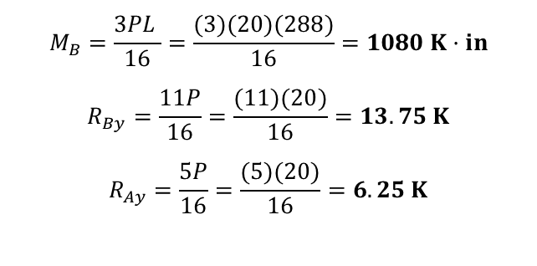
0.000 | 13.750 | 1080.000 | 0.000 | 0.000 | 0.000 | Miembro 1
0.000 | 0.000 | 0.000 | 0.000 | 0.000 | 0.000 | Miembro 2
MARCO ARTICULADO - ARTICULADO
Vector de Cargas Equivalentes
$$M_{B}=\frac{3PL }{16}=\frac{(3)(20)(288)}{16}=1080 K·in$$
$$R_{By}=\frac{11P}{16}=\frac{(11)(20)}{16}=13.75 K$$
$$R_{Ay}=\frac{5P}{16}=\frac{(5)(20)}{16}=6.25 K$$
 | 0.0
 | -13.8
Qk= | 1080.0
 | 0.0
 | 0.0
$A_{ML}$ =

Slide 24
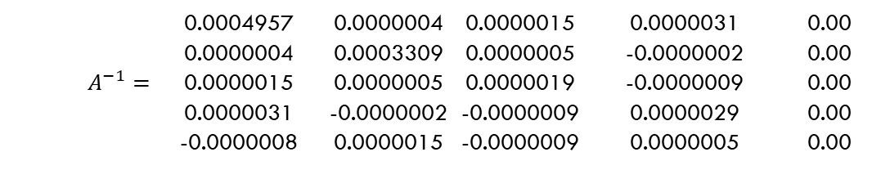

 | 0.0004957 | 0.0000004 | 0.0000015 | 0.0000031 | 0.00
 | 0.0000004 | 0.0003309 | 0.0000005 | -0.0000002 | 0.00
 | 0.0000015 | 0.0000005 | 0.0000019 | -0.0000009 | 0.00
 | 0.0000031 | -0.0000002 | -0.0000009 | 0.0000029 | 0.00
 | -0.0000008 | 0.0000015 | -0.0000009 | 0.0000005 | 0.00
 | 0.0004957 | 0.0000004 | 0.0000015 | 0.0000031 | 0.00
 | 0.0000004 | 0.0003309 | 0.0000005 | -0.0000002 | 0.00
 | 0.0000015 | 0.0000005 | 0.0000019 | -0.0000009 | 0.00
 | 0.0000031 | -0.0000002 | -0.0000009 | 0.0000029 | 0.00
 | -0.0000008 | 0.0000015 | -0.0000009 | 0.0000005 | 0.00
MARCO ARTICULADO - ARTICULADO
Obtención de Desplazamientos
 | 2048.31 | 0.00 | -3304.04 | -3304.04 | 0.00
 | 0.00 | 3031.03 | -1468.46 | 0.00 | -1468.46
A= | -3304.04 | -1468.46 | 704861.11 | 211458.33 | 140972.22
 | -3304.04 | 0.00 | 211458.33 | 422916.67 | 0.00
 | 0.00 | -1468.46 | 140972.22 | 0.00 | 281944.44
 | 0.0004957 | 0.0000004 | 0.0000015 | 0.0000031 | 0.00
 | 0.0000004 | 0.0003309 | 0.0000005 | -0.0000002 | 0.00
$$A^{−1}=$$ | 0.0000015 | 0.0000005 | 0.0000019 | -0.0000009 | 0.00
 | 0.0000031 | -0.0000002 | -0.0000009 | 0.0000029 | 0.00
 | -0.0000008 | 0.0000015 | -0.0000009 | 0.0000005 | 0.00
Multiplicando $A^{−1}$ por el vector de cargas equivalentes:
 | 0.0
 | -13.8
Qk= | 1080.0
 | 0.0
 | 0.0
Obtenemos los desplazamientos:
DESPLAZAMIENTOS
D1= | 0.001668
D2= | -0.004052
D3= | 0.002043
D4= | -0.001008
D5= | -0.001042
$A^{−1}$=
$A^{−1}$=

Slide 25
MARCO ARTICULADO - ARTICULADO
Obtención de Reacciones
Q6=-34.42 D1 + 3304.04 D3 +3304.04 D4 = -34.42 (0.001668) + 3304.04 (0.002043) +3304.04 (-0.001008)
Q7=-3020.83 D2 = -3020.83 (-0.004052)
Q8=-2013.89 D1 = -2013.89 (0.001668)
Q9=[-10.20 D2 + 1468.46 D3 +1468.46 D5 = -10.20 (-0.004052) + 1468.46 (0.002043) +1468.46 (-0.001042)]+6.25
Q6= | 3.360 K
Q7= | 12.240 K
Q8= | -3.360 K
Q9= | 7.760 K

Slide 26
MARCO CARGA PUNTUAL APLICADA
Marco con Carga Puntual Aplicada
Determine las reacciones en los soportes fijos ① y ③. Considere que E = 200 Gpa, I = 350(${10}^{6}$) ${mm}^{4}$ y A = 15(${10}^{3}$) ${mm}^{2}$ para cada elemento.
Y
Dado el modelo analítico mostrado, la figura tiene 5 grados de libertad sin restricción. Los cuales corresponden, 3 desplazamientos (giros) en el eje Z de los nodos ①, ② y ③. Y dos desplazamientos en el nodo ② en el eje X y Y.
X

Slide 27
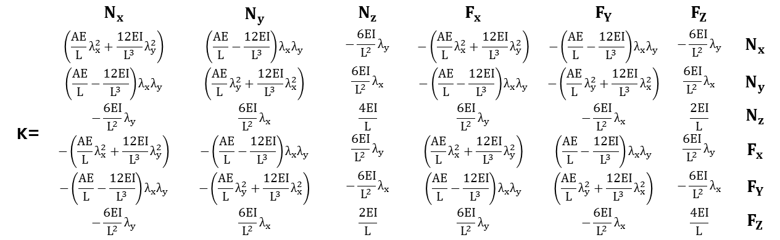


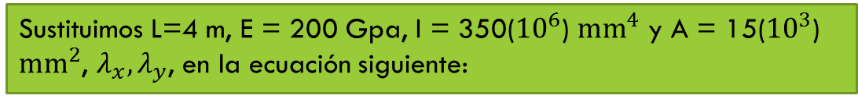
MARCO CARGA PUNTUAL APLICADA
Matriz de Rigidez del Miembro 1
Sustituimos L=4 m, E = 200 Gpa, I = 350(${10}^{6}$) ${mm}^{4}$ y A = 15(${10}^{3}$) ${mm}^{2}$, $λ_{x},λ_{y}$, en la ecuación siguiente:
$$λ_{x}=\frac{4−0}{4} =1$$
$$λ_{y}=\frac{0 −0}{4} =0$$
 | $$N_{x}$$ | $$N_{y}$$ | $$N_{z}$$ | $$F_{x}$$ | $$F_{Y}$$ | $$F_{Z}$$
 | $$\left(\frac{AE}{L}λ_{x}^{2}+\frac{12EI}{L^{3}}λ_{y}^{2}\right)$$ | $$\left(\frac{AE}{L}−\frac{12EI}{L^{3}}\right)λ_{x}λ_{y}$$ | $$−\frac{6EI}{L^{2}}λ_{y}$$ | $$−\left(\frac{AE}{L}λ_{x}^{2}+\frac{12EI}{L^{3}}λ_{y}^{2}\right)$$ | $$−\left(\frac{AE}{L}−\frac{12EI}{L^{3}}\right)λ_{x}λ_{y}$$ | $$−\frac{6EI}{L^{2}}λ_{y}$$ | $$N_{x}$$
 | $$\left(\frac{AE}{L}−\frac{12EI}{L^{3}}\right)λ_{x}λ_{y}$$ | $$\left(\frac{AE}{L}λ_{y}^{2}+\frac{12EI}{L^{3}}λ_{x}^{2}\right)$$ | $$\frac{6EI}{L^{2}}λ_{x}$$ | $$−\left(\frac{AE}{L}−\frac{12EI}{L^{3}}\right)λ_{x}λ_{y}$$ | $$−\left(\frac{AE}{L}λ_{y}^{2}+\frac{12EI}{L^{3}}λ_{x}^{2}\right)$$ | $$\frac{6EI}{L^{2}}λ_{x}$$ | $$N_{y}$$
K= | $$−\frac{6EI}{L^{2}}λ_{y}$$ | $$\frac{6EI}{L^{2}}λ_{x}$$ | $$\frac{4EI}{L}$$ | $$\frac{6EI}{L^{2}}λ_{y}$$ | $$−\frac{6EI}{L^{2}}λ_{x}$$ | $$\frac{2EI}{L}$$ | $$N_{z}$$
 | $$−\left(\frac{AE}{L}λ_{x}^{2}+\frac{12EI}{L^{3}}λ_{y}^{2}\right)$$ | $$−\left(\frac{AE}{L}−\frac{12EI}{L^{3}}\right)λ_{x}λ_{y}$$ | $$\frac{6EI}{L^{2}}λ_{y}$$ | $$\left(\frac{AE}{L}λ_{x}^{2}+\frac{12EI}{L^{3}}λ_{y}^{2}\right)$$ | $$\left(\frac{AE}{L}−\frac{12EI}{L^{3}}\right)λ_{x}λ_{y}$$ | $$\frac{6EI}{L^{2}}λ_{y}$$ | $$F_{x}$$
 | $$−\left(\frac{AE}{L}−\frac{12EI}{L^{3}}\right)λ_{x}λ_{y}$$ | $$−\left(\frac{AE}{L}λ_{y}^{2}+\frac{12EI}{L^{3}}λ_{x}^{2}\right)$$ | $$−\frac{6EI}{L^{2}}λ_{x}$$ | $$\left(\frac{AE}{L}−\frac{12EI}{L^{3}}\right)λ_{x}λ_{y}$$ | $$\left(\frac{AE}{L}λ_{y}^{2}+\frac{12EI}{L^{3}}λ_{x}^{2}\right)$$ | $$−\frac{6EI}{L^{2}}λ_{x}$$ | $$F_{Y}$$
 | $$−\frac{6EI}{L^{2}}λ_{y}$$ | $$\frac{6EI}{L^{2}}λ_{x}$$ | $$\frac{2EI}{L}$$ | $$\frac{6EI}{L^{2}}λ_{y}$$ | $$−\frac{6EI}{L^{2}}λ_{x}$$ | $$\frac{4EI}{L}$$ | $$F_{Z}$$

Slide 28


MARCO CARGA PUNTUAL APLICADA
Matriz de Rigidez del Miembro 1
Como resultado obtenemos:
$$λ_{x}=\frac{4−0}{4} =1$$
$$λ_{y}=\frac{0 −0}{4} =0$$
 | 8 | 9 | 5 | 1 | 2 | 3
 | 750 | 0 | 0 | -750 | 0 | 0 | 8
 | 0 | 13.125 | 26.25 | 0 | -13.125 | 26.25 | 9
K1= | 0 | 26.25 | 70 | 0 | -26.25 | 35 | 5
 | -750 | 0 | 0 | 750 | 0 | 0 | 1
 | 0 | -13.125 | -26.25 | 0 | 13.125 | -26.25 | 2
 | 0 | 26.25 | 35 | 0 | -26.25 | 70 | 3

Slide 29
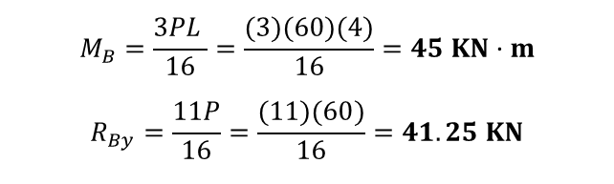
MARCO CARGA PUNTUAL APLICADA
Momentos de Empotramiento Perfecto del Miembro 1
Debido a que las cargas no están aplicadas sobre los nudos, las transformamos en cargas equivalentes mediante las formulas de empotramiento perfecto.
Evaluamos los momentos de empotramiento debido a la carga de 60 K utilizando las expresiones siguiente:
$$M_{B}=\frac{3PL }{16}=\frac{(3)(60)(4)}{16}=45 KN·m$$
$$R_{By}=\frac{11P}{16}=\frac{(11)(60)}{16}=41.25 KN$$

Slide 30
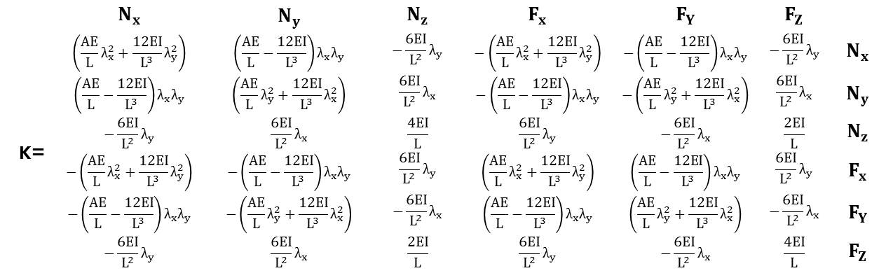


MARCO CARGA PUNTUAL APLICADA
Matriz de Rigidez del Miembro 2
Sustituimos L=4 m, E = 200 Gpa, I = 350(${10}^{6}$) ${mm}^{4}$ y A = 15(${10}^{3}$) ${mm}^{2}$, $λ_{x},λ_{y}$, en la ecuación siguiente:
$$λ_{x}=\frac{4 −4}{0} =0$$
$$λ_{y}=\frac{−4 −0}{4} =−1$$
 | $$N_{x}$$ | $$N_{y}$$ | $$N_{z}$$ | $$F_{x}$$ | $$F_{Y}$$ | $$F_{Z}$$
 | $$\left(\frac{AE}{L}λ_{x}^{2}+\frac{12EI}{L^{3}}λ_{y}^{2}\right)$$ | $$\left(\frac{AE}{L}−\frac{12EI}{L^{3}}\right)λ_{x}λ_{y}$$ | $$−\frac{6EI}{L^{2}}λ_{y}$$ | $$−\left(\frac{AE}{L}λ_{x}^{2}+\frac{12EI}{L^{3}}λ_{y}^{2}\right)$$ | $$−\left(\frac{AE}{L}−\frac{12EI}{L^{3}}\right)λ_{x}λ_{y}$$ | $$−\frac{6EI}{L^{2}}λ_{y}$$ | $$N_{x}$$
 | $$\left(\frac{AE}{L}−\frac{12EI}{L^{3}}\right)λ_{x}λ_{y}$$ | $$\left(\frac{AE}{L}λ_{y}^{2}+\frac{12EI}{L^{3}}λ_{x}^{2}\right)$$ | $$\frac{6EI}{L^{2}}λ_{x}$$ | $$−\left(\frac{AE}{L}−\frac{12EI}{L^{3}}\right)λ_{x}λ_{y}$$ | $$−\left(\frac{AE}{L}λ_{y}^{2}+\frac{12EI}{L^{3}}λ_{x}^{2}\right)$$ | $$\frac{6EI}{L^{2}}λ_{x}$$ | $$N_{y}$$
K= | $$−\frac{6EI}{L^{2}}λ_{y}$$ | $$\frac{6EI}{L^{2}}λ_{x}$$ | $$\frac{4EI}{L}$$ | $$\frac{6EI}{L^{2}}λ_{y}$$ | $$−\frac{6EI}{L^{2}}λ_{x}$$ | $$\frac{2EI}{L}$$ | $$N_{z}$$
 | $$−\left(\frac{AE}{L}λ_{x}^{2}+\frac{12EI}{L^{3}}λ_{y}^{2}\right)$$ | $$−\left(\frac{AE}{L}−\frac{12EI}{L^{3}}\right)λ_{x}λ_{y}$$ | $$\frac{6EI}{L^{2}}λ_{y}$$ | $$\left(\frac{AE}{L}λ_{x}^{2}+\frac{12EI}{L^{3}}λ_{y}^{2}\right)$$ | $$\left(\frac{AE}{L}−\frac{12EI}{L^{3}}\right)λ_{x}λ_{y}$$ | $$\frac{6EI}{L^{2}}λ_{y}$$ | $$F_{x}$$
 | $$−\left(\frac{AE}{L}−\frac{12EI}{L^{3}}\right)λ_{x}λ_{y}$$ | $$−\left(\frac{AE}{L}λ_{y}^{2}+\frac{12EI}{L^{3}}λ_{x}^{2}\right)$$ | $$−\frac{6EI}{L^{2}}λ_{x}$$ | $$\left(\frac{AE}{L}−\frac{12EI}{L^{3}}\right)λ_{x}λ_{y}$$ | $$\left(\frac{AE}{L}λ_{y}^{2}+\frac{12EI}{L^{3}}λ_{x}^{2}\right)$$ | $$−\frac{6EI}{L^{2}}λ_{x}$$ | $$F_{Y}$$
 | $$−\frac{6EI}{L^{2}}λ_{y}$$ | $$\frac{6EI}{L^{2}}λ_{x}$$ | $$\frac{2EI}{L}$$ | $$\frac{6EI}{L^{2}}λ_{y}$$ | $$−\frac{6EI}{L^{2}}λ_{x}$$ | $$\frac{4EI}{L}$$ | $$F_{Z}$$

Slide 31


MARCO CARGA PUNTUAL APLICADA
Matriz de Rigidez del Miembro 2
Como resultado obtenemos:
$$λ_{x}=\frac{4 −4}{0} =0$$
$$λ_{y}=\frac{−4 −0}{4} =−1$$
 | 1 | 2 | 3 | 6 | 7 | 4
 | 13.125 | 0 | 26.25 | -13.125 | 0 | 26.25 | 1
 | 0 | 750 | 0 | 0 | -750 | 0 | 2
K2= | 26.25 | 0 | 70 | -26.25 | 0 | 35 | 3
 | -13.125 | 0 | -26.25 | 13.125 | 0 | -26.25 | 6
 | 0 | -750 | 0 | 0 | 750 | 0 | 7
 | 26.25 | 0 | 35 | -26.25 | 0 | 70 | 4

Slide 32
MARCO CARGA PUNTUAL APLICADA
Matriz de Rigidez de la Estructura
Teniendo cada matriz de miembro, se ensambla la matriz de la estructura, conforme a la formula general de la matriz de rigideces de la estructura.
K=K1+K2
 | 1 | 2 | 3 | 4 | 5 | 6 | 7 | 8 | 9
 | 763.125 | 0 | 26.25 | 26.25 | 0 | -13.125 | 0 | -750 | 0 | 1
 | 0 | 763.125 | -26.25 | 0 | -26.25 | 0 | -750 | 0 | -13.125 | 2
 | 26.25 | -26.25 | 140 | 35 | 35 | -26.25 | 0 | 0 | 26.25 | 3
 | 26.25 | 0 | 35 | 70 | 0 | -26.25 | 0 | 0 | 0 | 4
K= | 0 | -26.25 | 35 | 0 | 70 | 0 | 0 | 0 | 26.25 | 5
 | -13.125 | 0 | -26.25 | -26.25 | 0 | 13.125 | 0 | 0 | 0 | 6
 | 0 | -750 | 0 | 0 | 0 | 0 | 750 | 0 | 0 | 7
 | -750 | 0 | 0 | 0 | 0 | 0 | 0 | 750 | 0 | 8
 | 0 | -13.125 | 26.25 | 0 | 26.25 | 0 | 0 | 0 | 13.125 | 9

Slide 33
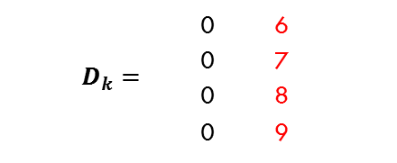

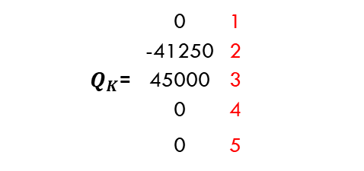
 | 0 | 6
 | 0 | 7
 | 0 | 8
 | 0 | 9
 | 0.0004957 | 0.0000004 | 0.0000015 | 0.0000031 | 0.00
 | 0.0000004 | 0.0003309 | 0.0000005 | -0.0000002 | 0.00
 | 0.0000015 | 0.0000005 | 0.0000019 | -0.0000009 | 0.00
 | 0.0000031 | -0.0000002 | -0.0000009 | 0.0000029 | 0.00
 | -0.0000008 | 0.0000015 | -0.0000009 | 0.0000005 | 0.00
 | 0.0004957 | 0.0000004 | 0.0000015 | 0.0000031 | 0.00
 | 0.0000004 | 0.0003309 | 0.0000005 | -0.0000002 | 0.00
 | 0.0000015 | 0.0000005 | 0.0000019 | -0.0000009 | 0.00
 | 0.0000031 | -0.0000002 | -0.0000009 | 0.0000029 | 0.00
 | -0.0000008 | 0.0000015 | -0.0000009 | 0.0000005 | 0.00
MARCO CARGA PUNTUAL APLICADA
Sistema de Ecuaciones
 | 0 | 1
 | -41250 | 2
$Q_{K}$= | 45000 | 3
 | 0 | 4
 | 0 | 5
 | 0 | 6
$$D_{k}=$$ | 0 | 7
 | 0 | 8
 | 0 | 9
$A^{−1}$=
$A^{−1}$=
$$D_{K}=$$

Slide 34
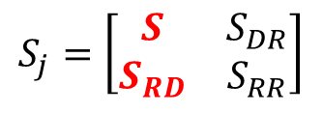
MARCO CARGA PUNTUAL APLICADA
Relación Carga – Rigidez - Desplazamientos
$$S_{j}=\left[\begin{matrix}S & S_{DR} \\ S_{RD} & S_{RR}\end{matrix}\right]$$
 |  | 1 | 2 | 3 | 4 | 5 | 6 | 7 | 8 | 9
0 |  | 763.125 | 0 | 26.25 | 26.25 | 0 | -13.125 | 0 | -750 | 0 |  | D1 | 1
-41250 |  | 0 | 763.125 | -26.25 | 0 | -26.25 | 0 | -750 | 0 | -13.125 |  | D2 | 2
45000 |  | 26.25 | -26.25 | 140 | 35 | 35 | -26.25 | 0 | 0 | 26.25 |  | D3 | 3
0.00 |  | 26.25 | 0 | 35 | 70 | 0 | -26.25 | 0 | 0 | 0 |  | D4 | 4
0.00 | = | 0 | -26.25 | 35 | 0 | 70 | 0 | 0 | 0 | 26.25 | X | D5 | 5
Q6 |  | -13.125 | 0 | -26.25 | -26.25 | 0 | 13.125 | 0 | 0 | 0 |  | 0.00 | 6
Q7 |  | 0 | -750 | 0 | 0 | 0 | 0 | 750 | 0 | 0 |  | 0.00 | 7
Q8 |  | -750 | 0 | 0 | 0 | 0 | 0 | 0 | 750 | 0 |  | 0.00 | 8
Q9 |  | 0 | -13.125 | 26.25 | 0 | 26.25 | 0 | 0 | 0 | 13.125 |  | 0.00 | 9

Slide 35
0.000 | 13.750 | 1080.000 | 0.000 | 0.000 | 0.000 | Miembro 1
0.000 | 0.000 | 0.000 | 0.000 | 0.000 | 0.000 | Miembro 2
MARCO CARGA PUNTUAL APLICADA
Sistema de Ecuaciones
0.000 | = | 763.125 | D1 | + | 0 | D2 | + | 26.25 | D3 | + | 26.250 | D4 | + | 0 | D5
-41250.00 | = | 0 | D1 | + | 763.125 | D2 | + | -26.25 | D3 | + | 0 | D4 | + | -26.25 | D5
-45000.000 | = | 26.25 | D1 | + | -26.25 | D2 | + | 140 | D3 | + | 35 | D4 | + | 35 | D5
0.000 | = | 26.25 | D1 | + | 0 | D2 | + | 35 | D3 | + | 70 | D4 | + | 0 | D5
0.000 | = | 2 | D1 | + | -26.25 | D2 | + | 35 | D3 | + | 0 | D4 | + | 70 | D5
Matriz S
763.125 | 0 | 26.25 | 26.250 | 0
0 | 763.125 | -26.25 | 0 | -26.25
26.25 | -26.25 | 140 | 35.000 | 35
26.25 | 0 | 35 | 70 | 0
2 | -26.25 | 35 | 0 | 70
$A_{ML}$ =

Slide 36
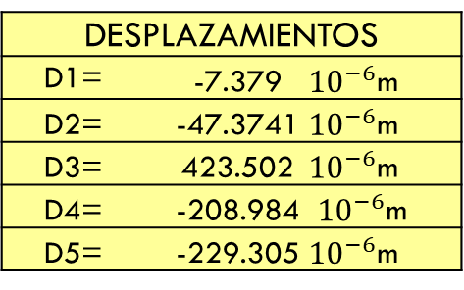

MARCO CARGA PUNTUAL APLICADA
Solución al Sistema de Ecuaciones
Desplazamientos
Matriz Inversa
Carga
D1
D2
D3
D4
D5
0.001330211 | -2.90348E-06 | -0.00016664 | -0.000415509 | 8.22308E-05 |  | 0
-4.00957E-06 | 0.001330432 | 0.000166805 | -8.1899E-05 | 0.000415509 |  | -41250
-0.000154109 | 0.000166639 | 0.009563903 | -0.004724161 | -0.004719462 | x | 45000
-0.000421775 | -8.22308E-05 | -0.00471946 | 0.016803611 | 0.002328894 |  | 0
3.75448E-05 | 0.000415675 | -0.00471464 | 0.00234324 | 0.016798912 |  | 0
D= $K^{−1}Q$
=
DESPLAZAMIENTOS
D1= |  | -7.379 | ${10}^{−6}$m
D2= |  | -47.3741 | ${10}^{−6}$m
D3= |  | 423.502 | ${10}^{−6}$m
D4= |  | -208.984 | ${10}^{−6}$m
D5= |  | -229.305 | ${10}^{−6}$m

Slide 37

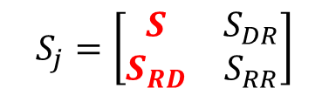
MATRIZ
MARCO CARGA PUNTUAL APLICADA
Cargas
$$S_{j}=\left[\begin{matrix}S & S_{DR} \\ S_{RD} & S_{RR}\end{matrix}\right]$$
Matriz $S_{RD}$
Desplazamientos
-13.125 | 0 | -26.25 | -26.25 | 0
0 | -750 | 0 | 0 | 0
-750 | 0 | 0 | 0 | 0
0 | -13.125 | 26.25 | 0 | 26.25
 | -7.379
X | -47.374
 | 423.502
 | -208.984
 | -229.305
CARGAS
Q6 = | -5.534 | KN
Q7 = | 35.531 | KN
Q8 = | 5.534 | KN * m
Q9 = | 24.469 | KN
$$S_{RD}$$

Slide 38
MATRIZ
CONCLUSIONES
Resolver marcos por el método de rigideces resulta practico, sin dejar a un lado que para ello se deben de realizar los cálculos de manera ordenada. Un factor importante para empezar a trabajar en un marco utilizando este sistema es cuando se comienza a etiquetar cada uno de los elementos de este mismo, esto hace posible la solución del sistema con la matriz de la estructura ensamblada conforme se propuso.
Para algunos resolver marcos puede ser mas complicado en comparación con las armaduras, esto depende del criterio personal de cada calculista, lo anterior se justifica de la siguiente manera: en cada nodo se toma en consideración los tres grados de libertad (cortante, momento y fuerza axial) esto hace que al final la matriz ensamblada resulte de 9x9 o 12x12.
Dentro del desarrollo de este método se debe contar con conocimiento previo de “operación de matrices” ya que cada miembro del marco contara con su “matriz del miembro” y estas a su vez se sumaran para formar lo que se llama Matriz ensamblada del marco.
$$S_{RD}$$

Slide 39
MATRIZ
BIBLIOGRAFIA
Análisis Estructural, Kassimelli 4th Ed.
Análisis Estructural, Hibbeler, 8va Ed.
Análisis de Estructuras, Jack C. McCCorman, 4th Ed.
Análisis Estructural, Gonzales Cuevas.
$$S_{RD}$$

Slide 40

Por su Atención, Gracias.

